Slide 1

Primer on Technical Malpractice in Machine Learning
Patrick Hall
George Washington University
All data scientists are bad. Some are useful.
-- Nihlist Data Scientist

Slide 2
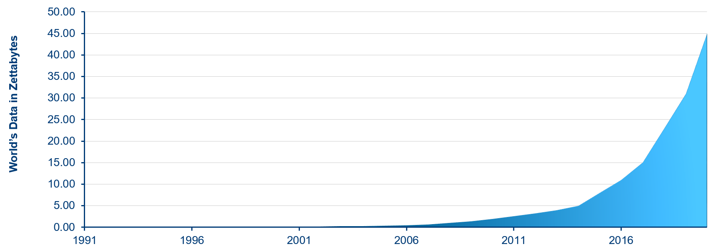
We’ve Been Lied to About Data
Why ?!
Data is often inaccurate, incomplete, obsolete, or just plain wrong.
Data often encodes human biases, sociological and otherwise.
Machine learning (ML) algorithms learn only from data. Hence, ML models are often inaccurate and biased.
We can only make good data-driven decisions if we are very careful.

Slide 3
The Scientific Method:
Develop a credible hunch (e.g., based on prior experiments or literature review)
Record a hypothesis
Collect data (e.g., using design of experiment)
Test hypothesis (e.g., using a double blind random construct)
Reproduce
The Data-scientific Method:
Assume we’ll make millions of dollars
Install GPU, download Python
Collect wrong, biased data from the internet or the exhaust of some business process
Surrender to confirmation bias:
Study collected data to form a hypothesis, i.e., which X, y and ML algorithm to use
Use the same data from hypothesis generation to test our hypothesis
Test our hypothesis with a high-capacity learning algorithm that can fit almost any set of loosely correlated X and y well
Change our hypothesis until our results are “good”
Don’t worry about reproducing, we’re all good bruh

Slide 4
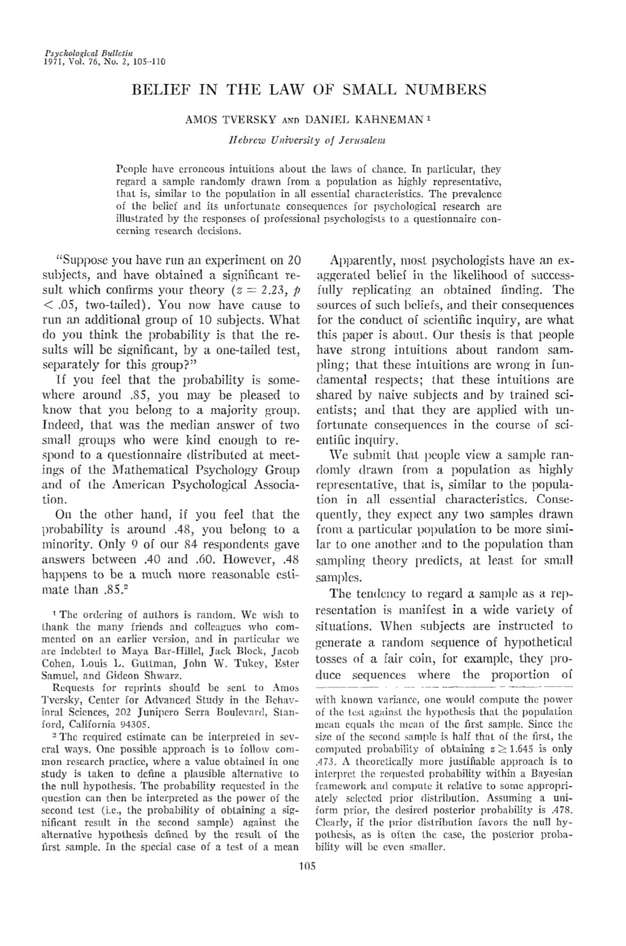
The Unique Properties of Data
Smart people have been making fun of bad data science before most of us were even born.
Data itself is a quantity with unique properties:
Data Generating Processes: most data is sampled from some known distribution
The Law of Large Numbers: results based on small samples exhibit high variance
Randomness: many real-world events are random, unconnected, and unpredictable
Regression to the Mean: most quantities are dominated by some expected value (mean)
These properties often drive results in data-driven experiments, decisions and products, especially when the data scientific method is employed.

Slide 5

Computers Do Not Understand.
Computers don’t understand their tasks.
They don’t understand the place of their tasks in the world.
Nor that there is a world.
Is this intelligence?
We must account for the context in which an ML system operates, because computers cannot.
Map apps like Waze have been accused of directing California drivers into wildfires, due to decreased traffic during emergency conditions.
Source: https://www.usatoday.com/story/tech/news/2017/12/07/ california-fires-navigation-apps-like-waze-sent-commuters-into-flames-drivers/930904001/.
Commentary based on: https://www.lrb.co.uk/the-paper/v43/n02/paul-taylor/insanely-complicated-hopelessly-inadequate.
Notes:
Additional parting shots:
ML is typically based on correlation, but correlation can mean nothing
Reliance on training data locks you into repeating the past

Slide 6
How to Be Better
Choose a specific, targeted application for ML tasks.
Know where your training data comes from and thoroughly verify its quality.
Select a reasonable number of uncorrelated, well-understood inputs with clear relationships to the modeling target.
Avoid black-box models, unless absolutely necessary.
Form hypotheses before in-depth data exploration.
Match models to the structure of the problem at hand.
Test real-world model performance -- good test data scores are not enough!
Ensure model performance is monitored once deployed.

